Slide 1

Stage 4 It's Under Your Nose Course Designer: Ken Wang
It's Under Your Nose is a 29 round, 145 point, COMSTOCK Long course. There are 14 USPSA targets and 1 steel target. The best two hits per target will score. Steel must fall to score. The start signal is audible.
The start position is standing anywhere in the shooting area. Firearm is unloaded and placed unsupported on the designated barrel. All reloading devices to be used in the course of fire are placed on top of the same barrel.
On the audible start signal, engage all targets from within the shooting area.

Slide 2
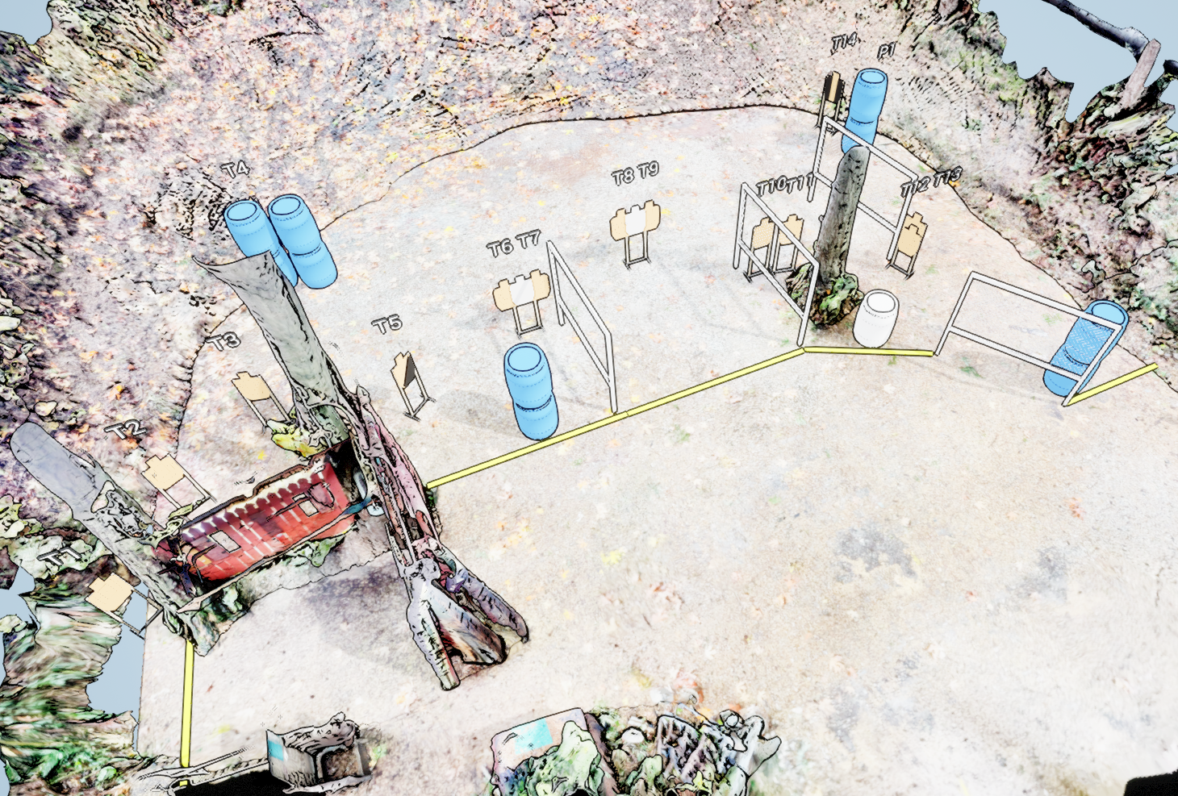
 | Stage 4 It’s Under Your Nose Course Designer: Ken Wang

